Slide 1
UGMP Workshop 1
2025-26
Meeting 1- Setting the Stage
Dr Andre Samuel

Slide 2
What is a UG Major Project?

Slide 3
What is a UG Major Project?
6,000 words piece of individual desk-based/secondary research
Focussed on a topic relevant to your business degree award and subject area

Slide 4
What is my Dissertation about?
It is YOUR dissertation – choice of topic entirely up to you!!!
Should be on a topic of contemporary interest.
Should be some connections to your course
Can be a subject topic studied in a previous module but don’t have to, if you wish
Must NOT, NOT, NOT be based on primary research data gathering
Notes:
Please immediately discuss this with your academic supervisor If during the preparation of the dissertation, the focus and direction of the dissertation change substantially from that outlined in your Proposal.

Slide 5
UGMP supervision group meeting
Group Meetings- Guidance on each chapter
Individual guidance- one on one, review drafts.

Slide 6
Dissertation Structure

Slide 7
The Research Process
adapted from: Saunders et al (2007, pg. 10) , Cooper and Schindler (2006, pg. 55)
Management Dilemma
Formulate and Clarify the Research Topic/Question
Critically Review the Literature
Formulate your Research Design
Data Collection and Preparation
Data Analysis and Interpretation
Conclusion and Recommendation
Dissertation Report
Management Decision/Action

Slide 8
UGMP Classical Structure
INPUT
OUTPUT
CHAPTER 1 – Introduction
What is the purpose of the research?
- Research Issue
- Rationale
-Aim
- Research Question
- Objectives
CHAPTER 2 --
Literature
What is already Known about the topic?
- Review of Underlying Theory
- Previous Research
-Models on the Topic
CHAPTER 3 – Research Design and Methodology
How was the data collected?
- Research Paradigm
- Methodology
- Data Collection Methods
CHAPTER 5
Conclusion and Recommendations
What are the key findings?
- Conclude on the findings for each research objective
- Recommendation i.e. answer to the RQ
CHAPTER 4- Findings and Analysis
What are the results?
- Present Results
- Discussion
- Interpretation of findings using literature
PROCESS

Slide 9
Marking Criteria
Contents | Criteria | Aprroximate Word Count | Mark (%)
Chapter 1- Introduction | Is the abstract adequate? Is there a clear purpose and rationale for the study? Clear set of objectives / research questions, and research relevance | 700 words | 10
Chapter 2- Use of Literature | Was the range suitable and adequate? Has a critical review of the literature been adopted? | 1300 words | 20
Chapter 3- Research Design & Methodology | Was research design and methodology discussed? Was the approach appropriate? | 1300 words | 20
Chapter 4- Results, Analysis & Interpretation of Data | Has the data been accurately been presented and analysed or are findings merely a description? Appropriate theory applied? Has the student attempted to interpret their findings? | 2000 words | 30
Chapter 5- Conclusion & Recommendations | Are conclusions reasoned? Do they correspond with the objectives of the research? | 700 words | 10
Presentation | Structure and language Harvard Referencing applied Use of tables / diagrams |  | 10

Slide 10
UGMP Report Structure
Title Page
Declaration Page
Acknowledgement
Abstract
  Set out on a page of its own immediately after the title page. The abstract is likely to be the last section to be written. It is a short (200 words maximum.) summary of the project (not an introduction) and should indicate the nature and scope of the work, outlining the research problem, key issues, findings, how you obtained your results and your conclusion/recommendations.
Table of Contents
  An outline of the whole project in list form, setting out the order of the sections, with page numbers. It is conventional to number the preliminary pages (abstract, table of contents) with lower case Roman numerals (i.e. (i), (ii), (iii) etc.) and the main text pages (starting with the first chapter) in Arabic numerals (1, 2, 3, etc.) as shown in the next page.

Slide 11
UGMP Report Structure
Lists of tables and figures
  You should present separate lists tables and figures you have included and their page numbers at the beginning of your report/project.
  A table is a presentation of data in tabular form; a figure is a diagrammatic representation of data or other material. Tables and figures should be clearly and consistently numbered, either above or below the table or figure.
  Each table and figure should have a separate heading (caption). The reader should be able to understand what the table or figure is about from this heading / caption without referring to the text for explanations. Nevertheless, they need to be discussed and analysed in the text. The numbers of the tables and the figures you use in the text and in the lists at the beginning should correspond exactly.
Main body of document, appropriately structured (this structure may vary depending on the nature of your report.) Chapter 1-5
References
Appendices (these should only contain material which is genuinely supportive of the argument in the main body of the report).

Slide 12
UGMP Report Structure
Other notes on recommended format:
Use letter size paper
Use a sans-serif font such as Arial, Calibri, Helvetica, etc
Type 1.5 or double-spaced.
Margins should be approximately:
  3 cms on left hand side of page to allow for binding.
  At least 1 cm on the right-hand side
  3 cms top and bottom
Pages should be numbered in a single sequence from the contents page onwards.

Slide 13
UGMP Report Structure
Other notes on recommended format:
Short quotations can run in the text within single quotation marks (double quotation marks reserved for quotations within quotations).
Quotations longer than about 30 words should be set in from the side of the page (normally the indent should be more than the paragraph indent).
Always write in complete sentences. Do not resort to note form.
Do not use abbreviations in the text unless they are for an organisation’s documents etc which are commonly initialised or referred to by acronyms e.g. BBC
All abbreviations must be explained when they first appear and included in the front of the document following the contents page and the list of tables and figures.
Refer to tables and figures from the body of the text

Slide 14
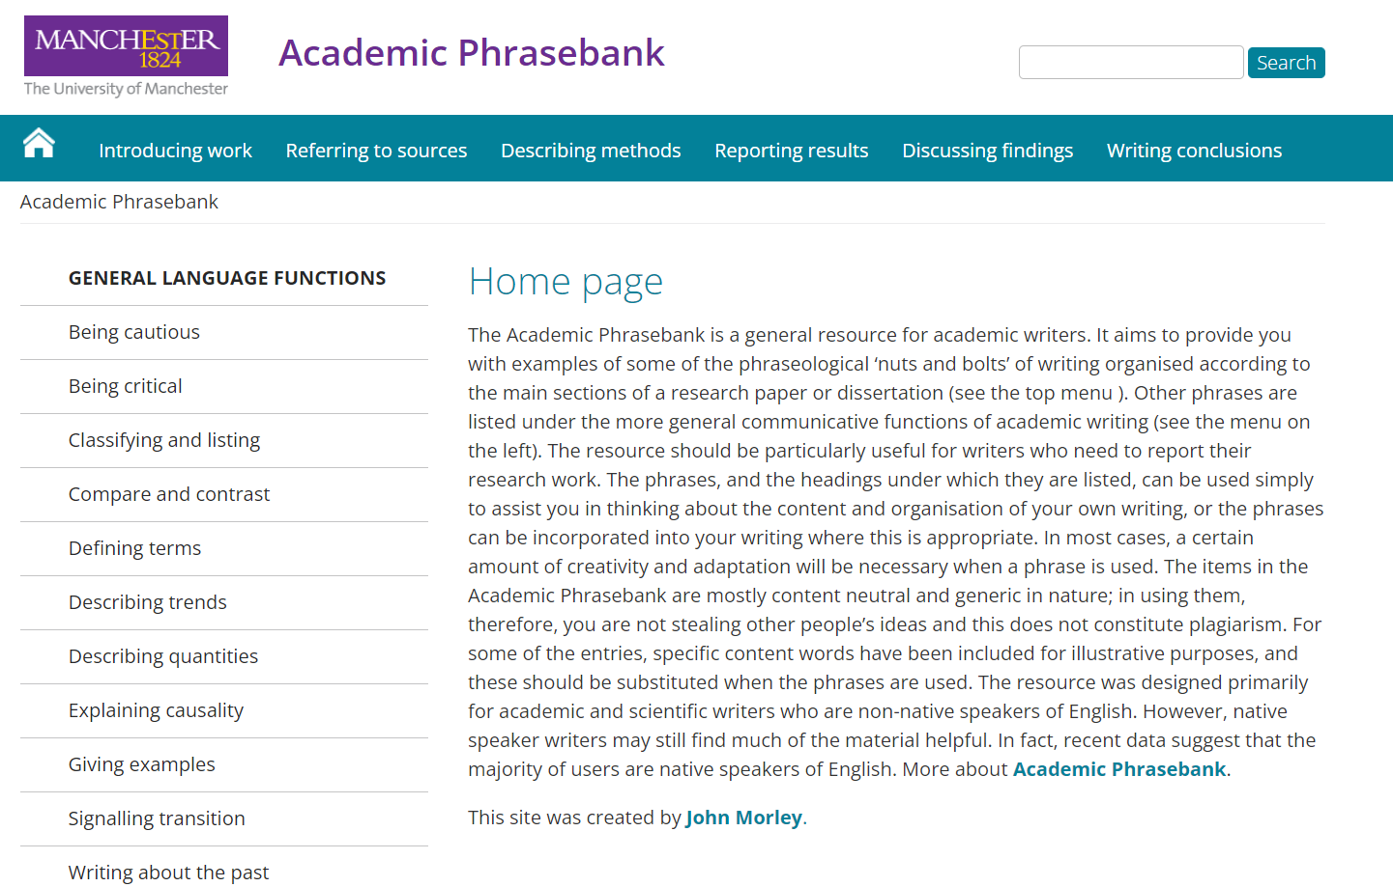
Dissertation Language
https://www.phrasebank.manchester.ac.uk/

Slide 15
Where to Start?- Idea Generation

Slide 16

How to get an Idea?
Previous Modules Yr 1-2
Your Interest
Career Path
BSc Specialization
Expertise
PRACTICE

Slide 17

Previous Modules Studied
Introduction to Financial Analysis & Management
Introduction to Financial Reporting
Financial Management
Performance Management
Taxation in the UK
Corporate Governance and Audit
International Financial Reporting
Advanced Corporate Finance
Banking and Financial Institutions
Financial Investment Analysis
What topics were you interested in

Slide 18
What Type of Research?
Secondary Data ONLY
What does this mean?:
  You will NOT collect any primary data through Questionnaires or Interviews
  You will use data already collected AND is publically available

Slide 19
Not all literature is created equal
Higher quality evidence
Research articles
Legislation / laws
Professional bodies
Case studies
Websites
Newspaper articles
Opinion pieces / blogs / social media
Increased risk of bias

Slide 20




Academic Journal Databases

Slide 21


Company and industry data

Slide 22
ARU Library Partner Access
EBSCOhost Business Source Premier | A searchable business and management database, containing full text articles from over 2,000 journals, country economic reports, company information and image collection.
EBSCOhost eBook Collection | Access to e-books from a wide range of publishers. Please note: You may find that it says “Business Source Premier” above the search box. If so, then click on this and choose to switch to “eBook Collection”.
Emerald Management | Business research tool that provides critical information with over 35,000 full text articles from Emerald's international management portfolio. Subject coverage spans a spectrum of management disciplines including: strategy; leadership; library and information management; marketing and human resource management; plus a substantial number of engineering, applied science and technology titles.
Overton | The world's largest searchable index of policy documents, guidelines, think tank publications and working papers from around the globe.
ProQuest Arts Premium | Full-text scholarly and industry journals covering Art, Design, Architecture, Humanities, Film and Screen Studies, Music, Performing Arts, and more.
ProQuest Ebook Central | More than 250,000 e-books covering all academic subject areas.
ProQuest SciTech Premium | Full-text scholarly and industry journals covering the Natural Sciences (Agricultural Science, Biological Science, Environmental Science, Earth, Atmospheric and Aquatic Science) and Technology (Advanced Technologies & Aerospace, Engineering and Materials Science).
ProQuest Social Science Premium | Full-text scholarly journals and other content, covering Politics, Sociology, Social Services, Anthropology, Criminology, Education, and more.

Slide 23
Previous Topics

Slide 24
Previous Topics
How are tax havens used for tax avoidance and evasion and its impacts on the economy?
The impact of covid 19 pandemic on the oil and gas industry financial performance using regression analysis
A critical analysis of “why do we as individuals pay taxes?”

Slide 25
An Investigation into the Relationship between Stock Prices and Financial Performance of Commercial Banks listed on the Trinidad and Tobago Stock Exchange
The Adaption of Online Banking in Developing Countries
A Critical Analysis of Corporate Governance in Non-Profit Organisations

Slide 26
Financial Reporting and Analysis Topics
Analyzing the impact of IFRS adoption on corporate investment decisions.
The impact of IFRS and GAAP convergence on financial reporting quality: a comparative study.
A comparative analysis of financial reporting practices in developed and emerging economies.
The impact of financial reporting quality on investor decision-making: a case study of company x.

Slide 27
Management Accounting Topics
Financial risk management strategies in the post-COVID era: lessons learned and future implications.
Evaluating the effectiveness of internal control systems: a comparative study of public and private companies.
The role of financial ratios in predicting financial distress: a comparative study.
How is profit analyzed between profit and non-profit organizations in the context of financial accounting in the UK?
The effectiveness of internal control systems: a comparative study of public and private companies.

Slide 28
ARU Suggested Topics
Available on Canvas

Slide 29
Let’s look at some of your initial Research areas ??

Slide 30
Let’s set some targets- Milestones!
Chapters | Finish Date for Drafts
Chapter 1 Introduction | Jan 31st
Chapter 2 Literature Review | Feb 21st
Chapter 3 Research Design and Methodology | Mar 7th
Chapter 4 Findings and Analysis | Mar 28th
Chapter 5 Conclusions and Recommendation | Apr 11th

Slide 31
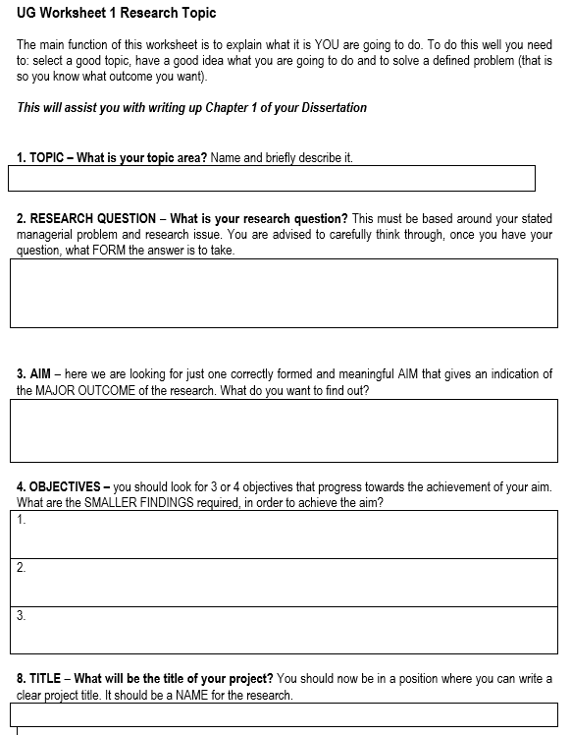
Complete Worksheet 1 for next week
UG Worksheet1-Research Description v1.3.doc

